Slide 1
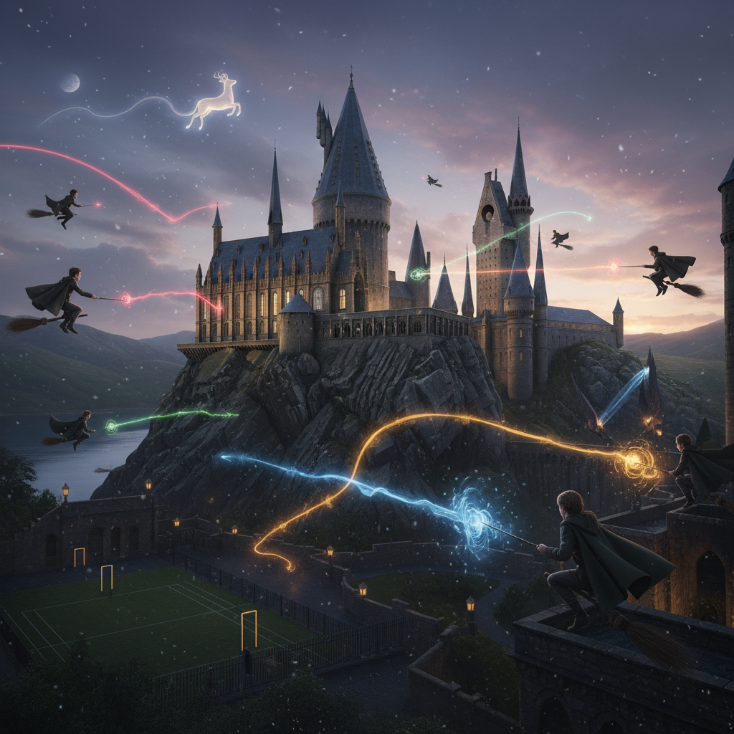

Slide 2
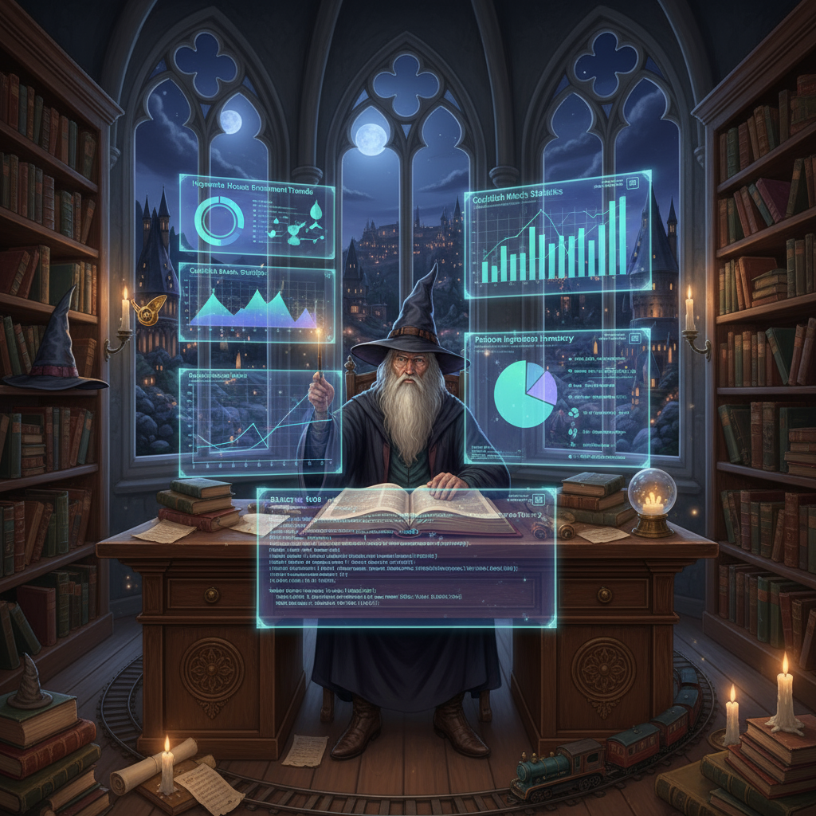

Agenda
Introduction
Objectives
Business Cases
Queries
Insights
Conclusion

Slide 3


The Harry Potter SQL Data Analysis Project is designed to analyze the magical world through data. This project simulates a real-world data analytics workflow using PostgreSQL – from data extraction to business insights.
Introduction:

Slide 4
To perform data-driven analysis of characters, dialogues, houses, spells, movies, and box office performance to understand:
Objective:
Character influence and scree presence
House dominance in dialogues and storylines
Financial insights from movie performance
Story engagement trends across books and movies

Slide 5
Business Use Cases:
Identify the most impactful characters and houses (for marketing/merchandising).
Correlate movie dialogues with box office revenue.
Discover story and character trends to guide content or franchise decisions.
Provide insights similar to media analytics (e.g., Netflix or Warner Bros).

Slide 6
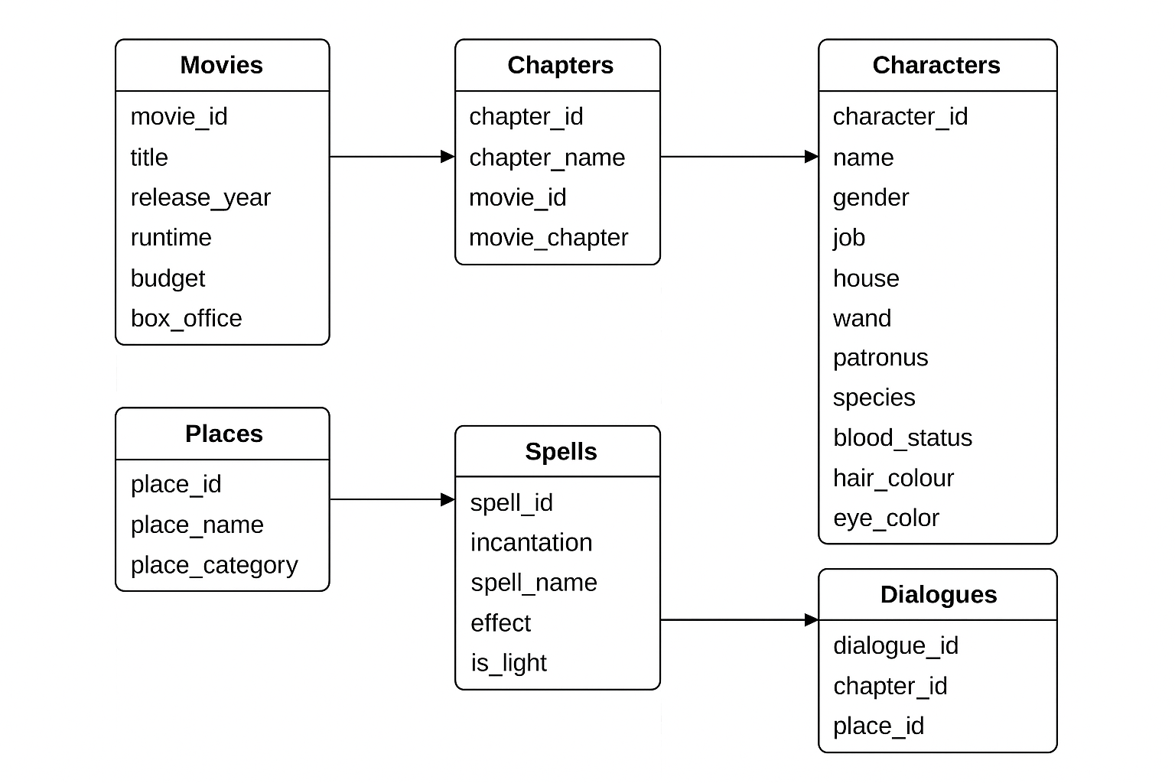
Schema Diagram

Slide 7
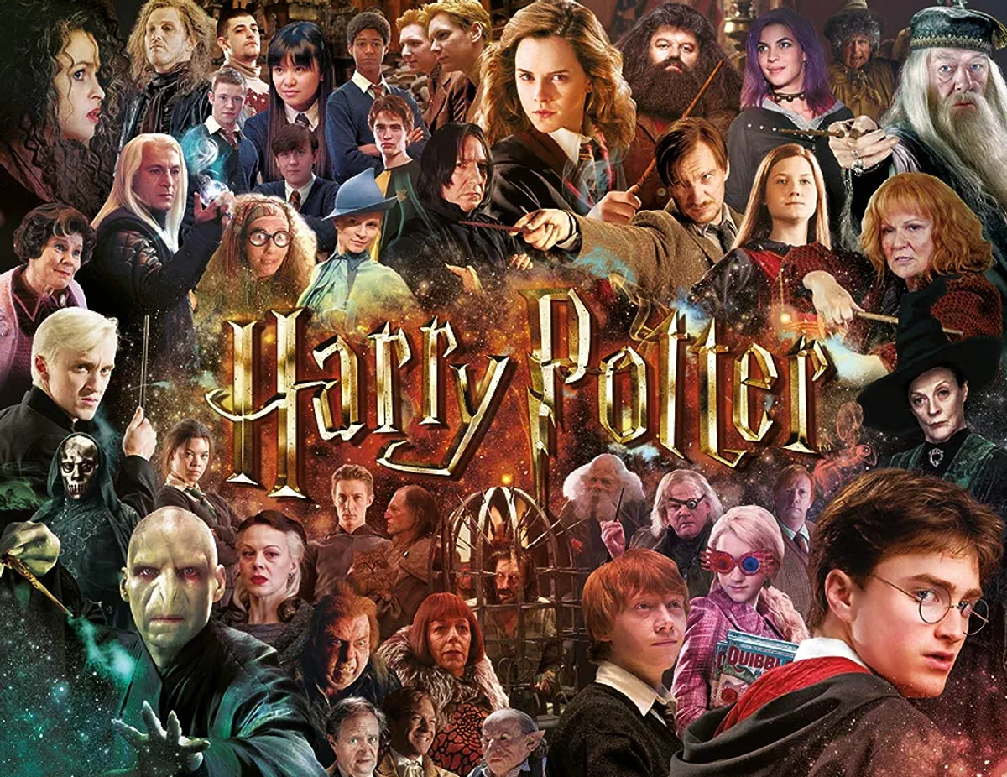
-- 1. Who are the main characters at Hogwarts?
SELECT *
FROM "character"
LIMIT 10;
Character_id | Name | Gender | Job | House | Wand | Patronus | Species | Blood_Status | Hair_Color | Eye_Color
1. | Harry James Potter | Male | Student | Gryffindor | Holly phoenix feather | Stag | Human | Half-blood | Black | Bright green
2 | Ronald Bilius Weasley | Male | Student | Gryffindor | Ash unicorn tail hair | Jack Russell terrier | Human | Pure-blood | Red | Blue
3 | Hermione Jean Granger | Female | Student | Gryffindor | Vine wood dragon heartstring | Otter | Human | Muggle-born | Brown | Brown
4 | Albus Percival Wulfric Brian Dumbledore | Male | Headmaster | Gryffindor | Elder Thestral tail hair core | Phoenix | Human | Half-blood | Silver| formerly auburn | Blue
5 | Rubeus Hagrid | Male | Keeper of Keys and Grounds | Professor of Care of Magical Creatures | Gryffindor | Oak unknown core | None | Half-Human/Half-Giant | Part-Human (Half-giant) | Black | Black

Slide 8
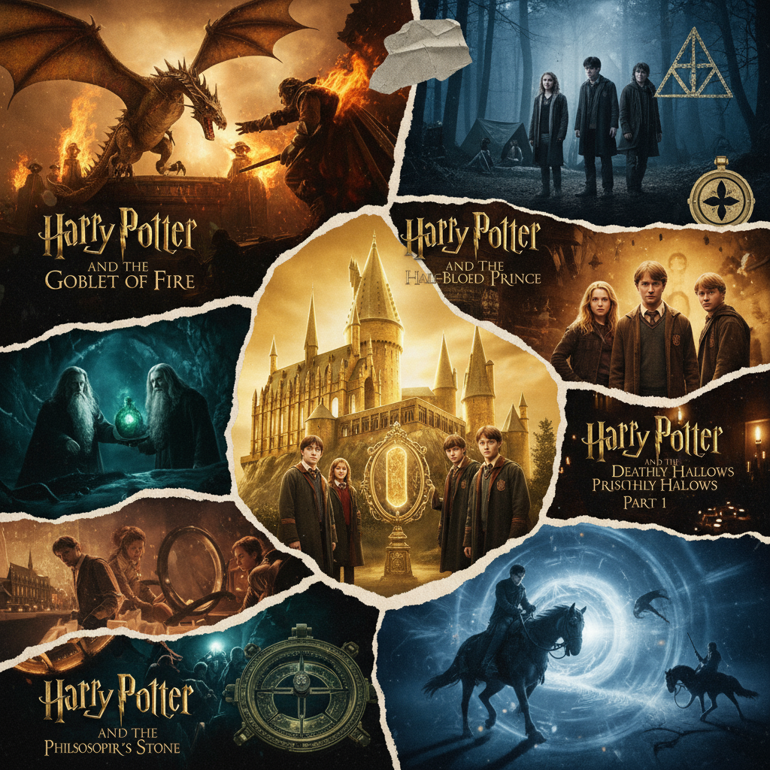
--2. When were the Harry Potter movies released?
SELECT movie_title, release_year
FROM movies
ORDER BY release_year;
 | movie_title | release_year
1. | Harry Potter and the Philosopher's Stone | 2001
2. | Harry Potter and the Chamber of Secrets | 2002
3. | Harry Potter and the Prisoner of Azkaban | 2004
4. | Harry Potter and the Goblet of Fire | 2005
5. | Harry Potter and the Order of the Phoenix | 2007
6. | Harry Potter and the Half-Blood Prince | 2009
7. | Harry Potter and the Deathly Hallows Part 1 | 2010
8. | Harry Potter and the Deathly Hallows Part 2 | 2011

Slide 9

-- 3. Which spell is most frequently cast in the books?
SELECT spell_name, COUNT(*) AS usage_count
FROM spells
GROUP BY spell_name
ORDER BY usage_count DESC
LIMIT 1;
spell_name | usage_count
Revulsion Jinx | 1

Slide 10
-- 4. Find most place name by dialogues
SELECT p.place_name, d.dialogues,
COUNT(p.place_id) AS total_count
FROM places p
JOIN Dialogue d ON d.place_id = p.place_id
GROUP BY place_name, d.dialogues
ORDER BY total_count DESC
LIMIT 5;
place_name | dialogues | total_count
Ministry of Magic | Stupify! | 5
Griffindor Common Room | What? | 4
The Burrow | Harry! | 4
Hagrid's Hut | What? | 4
The Burrow | Oh, it | 4

Slide 11
-- 5. Movie ROI
 | movie_title | release_year | budget | box_office | profit | roi_percentage
1. | Harry Potter and the Philosopher's Stone | 2001 | 125000000 | 1002000000 | 877000000 | 701.6
2. | Harry Potter and the Chamber of Secrets | 2002 | 100000000 | 880300000 | 780300000 | 780.3
3. | Harry Potter and the Prisoner of Azkaban | 2004 | 130000000 | 796700000 | 666700000 | 512.85
4. | Harry Potter and the Goblet of Fire | 2005 | 150000000 | 896400000 | 746400000 | 497.6
5. | Harry Potter and the Order of the Phoenix | 2007 | 150000000 | 942000000 | 792000000 | 528
6. | Harry Potter and the Half-Blood Prince | 2009 | 250000000 | 943200000 | 693200000 | 277.28
7. | Harry Potter and the Deathly Hallows Part 1 | 2010 | 200000000 | 976900000 | 776900000 | 388.45
8. | Harry Potter and the Deathly Hallows Part 2 | 2011 | 250000000 | 1342000000 | 1092000000 | 436.8
SELECT movie_title, release_year, budget, box_office, (box_office - budget) AS profit, ROUND(((box_office - budget) * 100.0 / budget), 2) AS roi_percentage FROM movies

Slide 12
-- 6. Top Places by Activity
 | place_name | place_category | lines_spoken | unique_characters_
1. | Great Hall | Hogwarts | 556 | 49
2. | 4 Privet Drive | Dwellings | 347 | 22
3. | Griffindor Common Room | Hogwarts | 343 | 28
4. | Ministry of Magic | Other Magical Locations | 323 | 28
 | Hagrid's Hut | Hogwarts | 311 | 13
 | Headmaster's Office | Hogwarts | 296 | 16
7. | The Burrow | Dwellings | 295 | 29
8. | Defense Against the Dark Arts Classroom | Hogwarts | 262 | 21
9. | 12 Grimmauld Place | Dwellings | 261 | 21
10. | Potions Classroom | Hogwarts | 231 | 23
SELECT p.place_name, p.place_category, COUNT(d.dialogue_id) AS lines_spoken, COUNT(DISTINCT d.character_id) AS unique_characters_FROM places p LEFT JOIN Dialogue d ON d.place_id = p.place_id GROUP BY p.place_name, p.place_category ORDER BY lines_spoken DESC LIMIT 10;

Slide 13
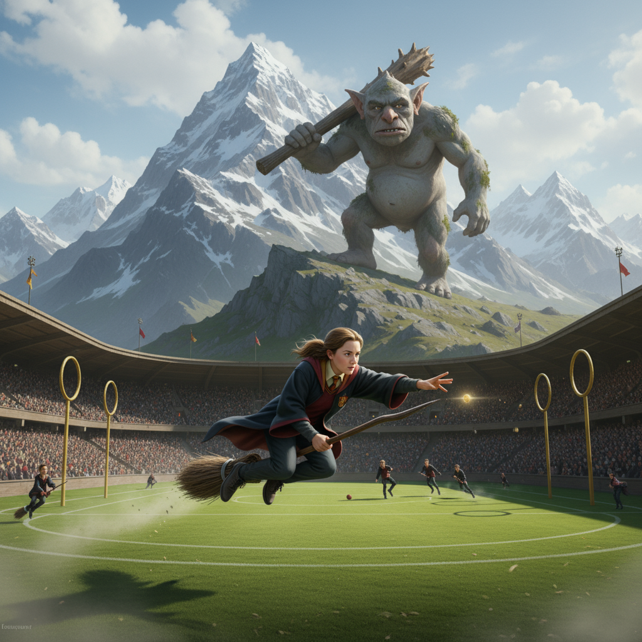
-- 7. Popular 3 chapters by dialogues
 | chapter_name | dialogues | total_dialogues
1. | Quidditch | Yay! | 3
2. | New Seeker | Up! | 2
3. | Mountain Troll | Well, what it is... | 2
SELECT c.chapter_name, d.dialogues, COUNT(d.dialogue_id) AS total_dialogues FROM Chapters c JOIN Dialogue d ON d.chapter_id = c.chapter_id GROUP BY c.chapter_name, d.dialogues ORDER BY total_dialogues DESC LIMIT 3;

Slide 14
-- 8. Top movies with runtime between 140 & 160
SELECT movie_title, release_year, runtime FROM movies WHERE runtime BETWEEN 140 AND 160 ORDER BY runtime DESC;
 | movie_title | release_year | runtime
1. | Harry Potter and the Goblet of Fire | 2005 | 157
2. | Harry Potter and the Half-Blood Prince | 2009 | 153
3. | Harry Potter and the Philosopher's Stone | 2001 | 152
4. | Harry Potter and the Deathly Hallows Part 1 | 2010 | 146
5. | Harry Potter and the Prisoner of Azkaban | 2004 | 142

Slide 15
-- 9. Find the highest chapter name for each movie
SELECT c.chapter_name, m.movie_title, m.release_year FROM movies m JOIN Chapters c ON m.movie_id = c.movie_id WHERE c.movie_chapter = ( SELECT MAX(c.movie_chapter) FROM Chapters c WHERE c.movie_id = m.movie_id );
 | chapter_name | movie_title | release_year
1. | Interference Overcome | Harry Potter and the Philosopher's Stone | 2001

Slide 16
-- 10. Analyse spells by incantation complexity
SELECT incantation, COUNT(*) AS times_used FROM spells GROUP BY incantation ORDER BY times_used DESC;
 | incantation | times_used
1. | Salvio hexia | 1
2. | Oppugno | 1
3. | Incarcerous | 1
4. | Alohomora | 1
5. | Lumos Solem | 1

Slide 17
-- 11. Which movie had the most dialogues?
SELECT m.movie_title, COUNT(dialogue_id) AS total_dialogues FROM Dialogue d JOIN Chapters ch ON d.chapter_id = ch.chapter_id JOIN movies m ON ch.movie_id = m.movie_id GROUP BY m.movie_title ORDER BY total_dialogues DESC LIMIT 1;
 | movie_title | total_dialogues
1. | Harry Potter and the Philosopher's Stone | 525

Slide 18

-- 12. List of all characters who belong to Gryffindor House?
SELECT "Name", "House“ FROM Character WHERE "House" = 'Gryffindor';
 | Name | House
1. | Harry James Potter | Gryffindor
2. | Ronald Bilius Weasley | Gryffindor
3. | Hermione Jean Granger | Gryffindor
4. | Albus Percival Wulfric Brian Dumbledore | Gryffindor
5. | Rubeus Hagrid | Gryffindor
6. | Neville Longbottom | Gryffindor
7. | Fred Weasley | Gryffindor
8. | George Weasley | Gryffindor

Slide 19

-- 13. Which house has the highest number of students?
SELECT "House", COUNT(*) AS total_students FROM Character GROUP BY "House“ ORDER BY total_students DESC LIMIT 1;
 | House | total_students
1. | Gryffindor | 76

Slide 20
Insights from this project
Gryffindor has the most characters and dialogues.
Harry, Hermione, and Ron talk the most — main heroes of the story.
Expelliarmus is the most used spell.
Movies with longer screen time (140–160 mins) did well at the box office.
Chapters in the middle of the story have more dialogues and action.
Hogwarts Great Hall and Forbidden Forest are the most active places.

Slide 21
Key takeaways
Gryffindor leads the story in both people and power.
More dialogues = more audience engagement and better movie success.
Data helps us see story patterns and what fans love most.
This project shows how data can make stories and business decisions smarter.

Slide 22

Thank you
Khushbu Soni
khushbu.ksonii@gmail.com
linkedin.com/in/khushbu-soni18

